Slide 1
Thinking Ahead: Creating an Estate Plan
With Peter Temple, Esq. and Emily Temple Abels, Esq.
Larmore Scarlett LLP
123 E. Linden Street
Kennett Square, PA 19348

Slide 2
WHY EVEN HAVE A plan?
“And what happens if I don’t? I won’t be around to deal with it.”
All states have intestacy statutes to direct the transfer of assets if no will is found. Having a will not only ensures that the people and organizations you trust get your assets, but if done correctly, it can save your loved ones time, money and aggravation.
Notes:
State laws vary as to how wills and trusts are handled, and each state has laws to handle situations when someone dies without a will. But very simply, if you pass without a will, you lose the only chance you have to exercise control about how things should be handled after you pass away. We can’t control much when we are gone but we can ensure our loved ones know our wishes, and have the satisfaction of carrying out our requests.

Slide 3
Defining your goals
Charitable giving
Provide for children and grandchildren (or several generations beyond)
Protect assets for a particular person, who perhaps may not be able to safeguard or manage assets themselves
Make things as easy for your spouse as possible
Avoid taxation
Notes:
Since no one can take it all with them, it’s important to think about what happens after you’re gone.
You may find, or have found, yourself planning with your family as this family is here. At least everyone here seems to have a clearly defined role! (ha ha ha)
It can be tempting to jump into estate planning focused on the details—who gets what, when, etc. That is critical of course, but the first step should be to define your goals. Would you like to provide for charity wholly or in part? Would you like to provide for your family? Are you concerned about how your partner will support themselves after you are gone? Etc etc.
Usually folks want several things to be accomplished with their estate plan, and that is easy to do with a lawyer’s help. What a lawyer cannot do is determine which structures best meet the needs of the family or of you, the client, with your input as to what the priorities are.

Slide 4
Get organized (at least somewhat)
Think through where your accounts are held, the approximate balances, and what type of accounts they are. Consider (and verify) how the account is titled, who or what is listed as the beneficiary on the account, and make a list of accounts, financial advisors, and tax accountants so that your financial information is easily ascertained by your family, and ready for a meeting with an estate lawyer.
Notes:
A lawyer or financial planner will need that information to be able to recommend to you why a particular estate plan structure might be more efficient or effective than another.
Beneficiary designations
Safe deposit boxes
Keep copies of your documents at home, accessible to you for your review

Slide 5
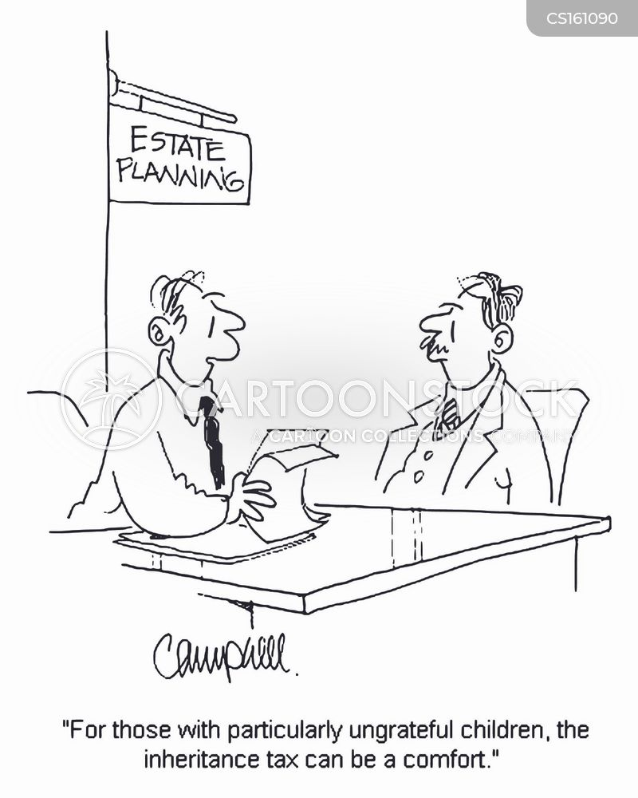
What’s in an estate plan
A will or trust (or both)
Durable power of attorney for finances
Durable power of attorney for healthcare
Advance Directive

Slide 6
WILL vs. trust
In Pennsylvania, wills and trusts are treated nearly equally by statute. The fees to administer them are the same, and the waiting and creditor claim periods required of both, are each one year.
A will is a document which directs disposition of your assets at your death. A trust is created during your life, and either funded with assets then or at your death. Trusts are often touted to avoid probate (a will must be probated) but often, in PA, is not a goal worth having.
Notes:
A will and estate are managed by an executor; a trust by a trustee or trustees.
In other states, there are significant advantages to having a trust, and as always, the details of your goals and your family’s situation will change which documents are the best fit.

Slide 7
What is probate?
And don’t I need to avoid it??
Think of probate as a bridge, ensuring your assets can transfer legally from the decedent to their intended recipients. In Pennsylvania, probate fees are small, and the trust administration process is very similar in cost and time.
Notes:
Trusts can be the right tool in certain situations, but they are often touted by national financial planners as a way to protect your assets from probate and tax, when in Pennsylvania, that isn’t needed.
Important to remember we are PA lawyers, so residents of Maryland and Delaware here should be sure to get state-specific advice!

Slide 8
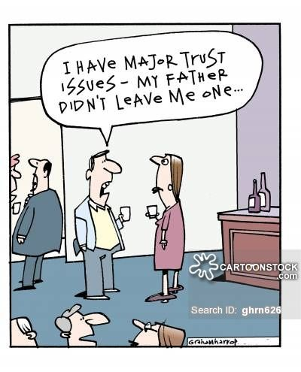
Your family and your estate plan
Your family does not need to know all the ins and outs of your estate plan. However, it would be wise to let loved ones know where to find your estate documents, and what to do when you pass.
Notes:
If you would like to discuss the outline of your estate plans with your family, of course that is your prerogative to do so. We tend to advise our clients not to distribute copies of documents because there is always the chance you might want to make a change or an update, and then a copy is floating out in the world which may some day confuse matters.
It can be helpful for families to have a basic sense of what your wishes are and that you’ve thought about what’s to come, so if it is comfortable to do so, we encourage you to speak with your family about your wishes and your general estate plan disposition (especially if you plan to name that family member to a role in your will.)

Slide 9
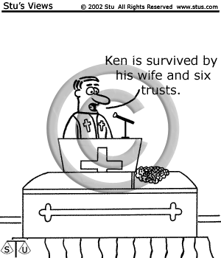
Casting your estate planning play
Executor(s)
Trustee(s)
Agent(s)
Guardian(s)
The same individual or individuals may play many roles, or you may want to assign different friends, family or trusted professionals to these.
Notes:
Roles to fulfill and their duties

Slide 10
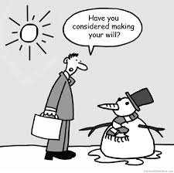
DURABLE FINANCIAL Power of attorney
Created to empower an agent or agents to manage your affairs if you should become unable to do so
Only valid while you are alive
Often gives your designated agent a large amount of power over your affairs—it’s important to know the details of what your power of attorney document authorizes

Slide 11
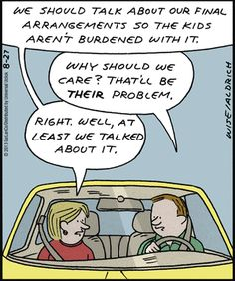
HEALTHCARE DIRECTIVES
Unlike the power of attorney for finances, this is a narrow document that gives someone else the power to make healthcare decisions for you if you are unable to communicate your own wishes.
Healthcare power of attorney and advance directive document go hand in hand; the advance directive document provides guidance to the agent designated in your power of attorney.
Notes:
Different from POLST document which you must do with your doctor, and is the only “pull the plug” document of these we’ve mentioned

Slide 12
Other ways to prepare
Beneficiary designations– make sure these are done with awareness of tax benefits (or lack thereof) and to coincide with your estate documents
These accounts will pass per designations, but outside your will
Inheritance Tax in PA
0% between spouses
4.5% to children and grandchildren
12% to brothers and sisters
15% to everyone else
Notes:
Tax-deferred accounts should have your spouse or your estate named, but conventional wisdom is that it should pass to your spouse
Distinguish inheritance tax from federal estate tax

Slide 13
Stay in touch
Emily T. Abels
(610) 444-3737 ext. 223
emily@larmorecarlett.com
L. Peter Temple
(610) 444-3737 ext. 115
peter@larmorescarlett.com
Larmore Scarlett LLP
123 E. Linden Street
Kennett Square, PA
19348
larmorescarlett.com
Notes:
Thank you so much for your time this morning, Friends!
Questions?

